Slide 1
Filtering in the Frequency Domain
Mr. ANWAR KHAN
Dept. of Computer Science
University of Lahore

Slide 2
Objectives
This lecture reviews frequency domain filtering.
  Frequency bands
  Lowpass filter
    Ideal, Butterworth, Gaussian
  Highpass filter
    Ideal, Butterworth, Gaussian

Slide 3
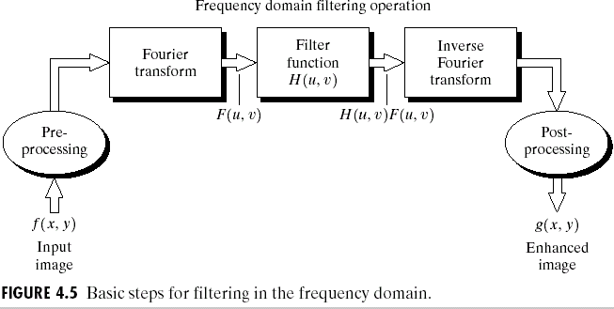
Basic Steps

Slide 4
Basics
Steps for filtering in the frequency domain
Input: M × N image f(x, y) Output: M × N image g(x, y)
Padded images: P × Q images f_{P} (x, y) and g_{P} (x, y) (P = 2M , Q = 2N )
Zero pad f(x, y) ⇒ f_{P} (x, y)
Multiply f_{P} (x, y) by (−1)^{(x+y)}
Compute F (u, v), that is the FT of the result in (2)
Multiply F (u, v) by H(u, v) (array multiplication)
Compute the IFT of the result in (4)
Obtain the real part of the result in (5)
Multiply the result in (6) by (−1)^{(x+y)} ⇒ g_{P} (x, y)
Crop g_{P} (x, y) ⇒ g(x, y)

Slide 5
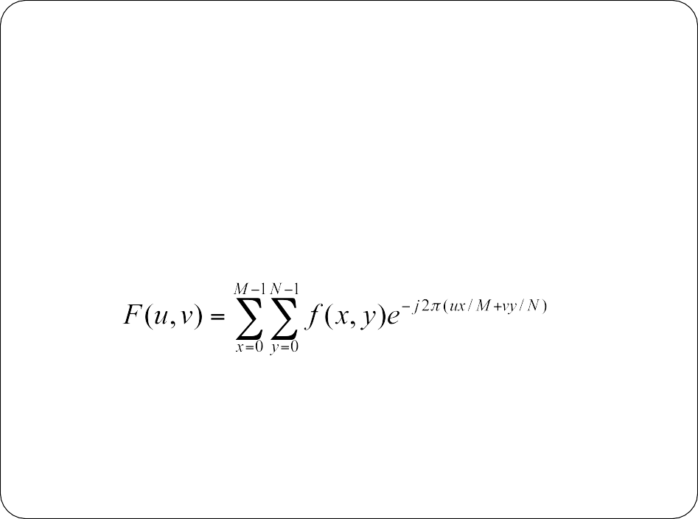



The Discrete Fourier Transform (DFT)
Origin
M
1. Given an image f(x,y) or size MxN
x = 0, 1, 2…M-1
y = 0,1,2…N-1
N
2. Discrete Fourier Transform of f(x, y) is given by
u = 0, 1, 2…M-1
v = 0, 1, 2…N-1
j= sqrt(-1)

Slide 6
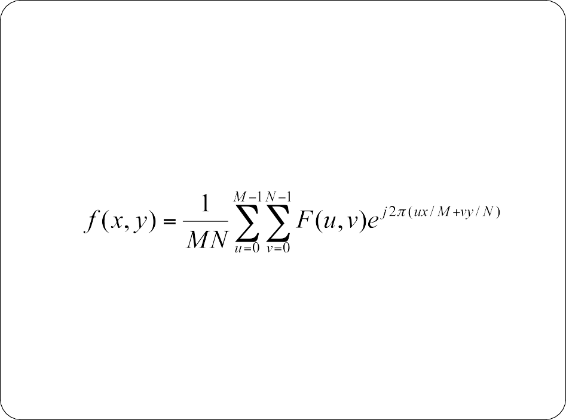
The Inverse DFT
The key feature of a Fourier Transform is that it’s completely reversible
The inverse DFT is given by:
x = 0, 1, 2…M-1
y = 0, 1, 2…N-1

Slide 7


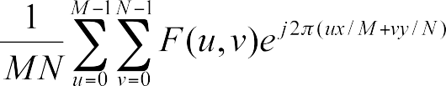
The Inverse DFT

Slide 8
Frequency Bands
Low frequencies: general graylevel appearance over smooth areas: slowly varying grayscales.
High frequencies: responsible for detail, such as edges and noise.
A filter that attenuates high frequencies while “passing” low frequencies is a lowpass filter.
A filter that attenuates low frequencies while “passing” high frequencies is a highpass filter.
Lowpass filters blur images.
Highpass filters highlight edges.

Slide 9
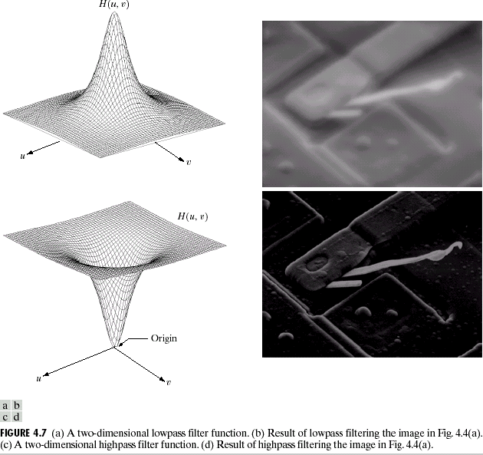
Lowpass and Highpass Filters
Lowpass filter
Highpass filter

Slide 10



1. Low-pass Filters
Attenuates high frequencies and retains low frequencies unchanged.
  high frequencies correspond to sharp intensity changes
The result in the spatial domain is equivalent to that of a smoothing filter
  fine-scale details and noise in the spatial domain image are filtered

Slide 11
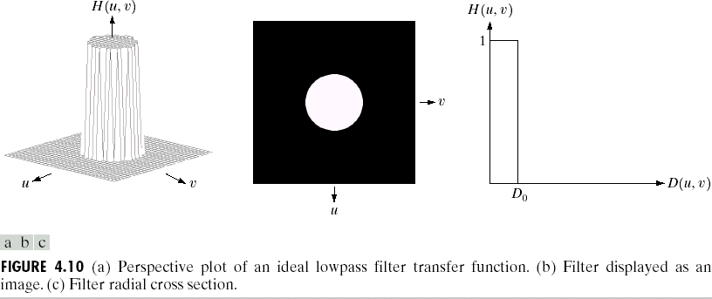
Ideal Lowpass Filter
cutoff frequency

Slide 12
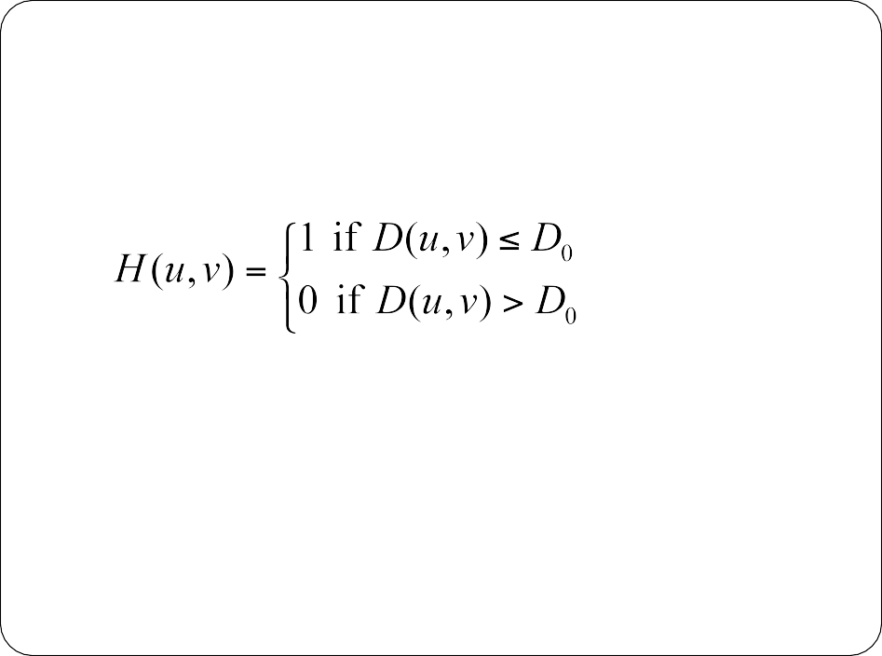
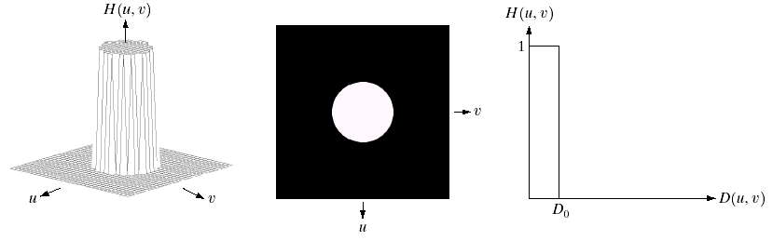
The transfer function for the ideal low pass filter can be given as:
Ideal Low Pass Filter

Slide 13
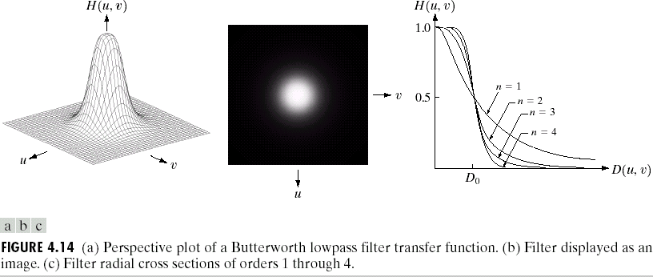
Butterworth Lowpass Filter (BLPF)
1
H (u, v) =
1 + [D(u, v) / D ]^{2n}
n is filter order
0

Slide 14
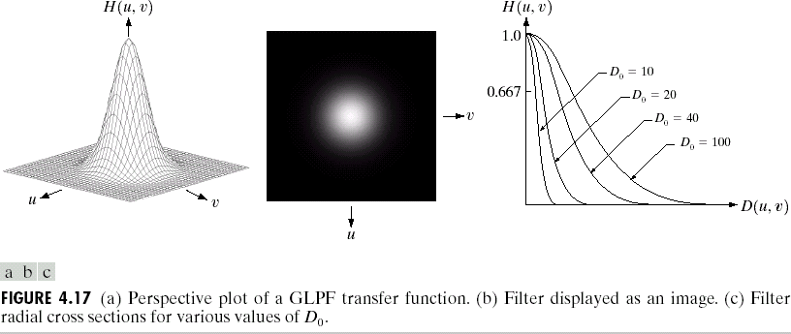
Gaussian Lowpass Filter (GLPF)
2
2
σ = D₀ = cutoff freq
H (u, v) = e
− D (u ,v) / 2 D
0

Slide 15

1. High-pass Filters
Attenuates high frequencies and retains low frequencies unchanged.
  high frequencies correspond to sharp intensity changes
The result in the spatial domain is equivalent to that of a smoothing filter
  fine-scale details and noise in the spatial domain image are filtered

Slide 16
High-pass Filters
A highpass filter yields edge enhancement or edge detection in the spatial domain
Edges contain mostly high frequencies while other areas of the image are rather constant gray level (i.e. low frequencies) which are suppressed.

Slide 17
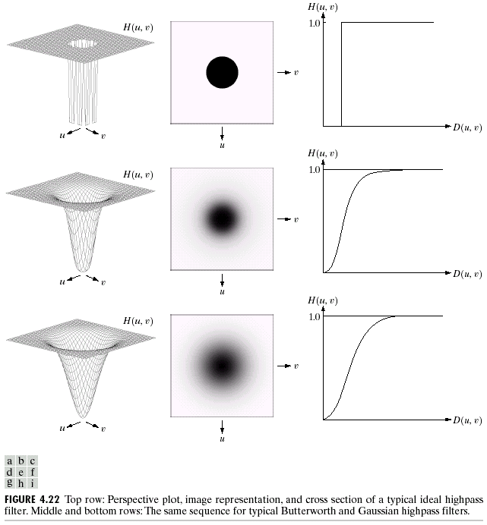
Highpass Filters: 1-H_{LP}
Ideal highpass filter
0 if D(u, v) ≤ D
⎧
0
H (u, v) =
⎨
⎩1 if D(u, v) > D₀
Butterworth highpass filter
1
]2n
H (u, v) =
1+ [D D(u, v)
0
Gaussian highpass filter
2 2
H (u, v) = 1− e
− D (u ,v) / 2 D
0

